Slide 1


Oviedo Sandoval Esteban Orlando
14/11/2024

Slide 2

Outline
Executive Summary
Introduction
Methodology
Results
Conclusion
Appendix

Slide 3
Executive Summary
Summary of methodologies
Data collection API
Data Collection with Web Scraping
Data Wrangling
Data Analysis with SQL
Visual Analytic with Folium
Dashboard with Dash
Model prediction with Machine Learning
Summary of all results
EDA Results
Interactive Analytics graphics
Correlations and predictive Modeling results

Slide 4
Introduction
Project background and context
In this project, we worked on the space rocket launches by the company SpaceX, specifically on the Falcon 9. The aim is to determine if the rocket will be launched successfully. By knowing this, we can determine the cost of the launch and future launches
Problems you want to find answers
What determines a successful launch?
What is the cost of those launches?

Slide 5

Section 1

Slide 6
Methodology
Executive Summary
Data collection methodology:
The SpaceX API was used along with web scraping
Perform data wrangling
The data was collected and transformed into complex and disorganized datasets in more user-friendly formats for Machine Learning models
Perform exploratory data analysis (EDA) using visualization and SQL
Perform interactive visual analytics using Folium and Plotly Dash
Perform predictive analysis using classification models
Different models, such as KNN or SVM, were created to evaluate which one provided the best results

Slide 7
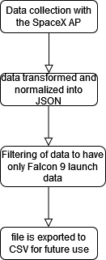
Data Collection
The data is collected using the SpaceX API, and this data is transformed into JSON format and normalized. We filter the data to have information only on Falcon 9 rocket launches and export the file to CSV for future use

Slide 8
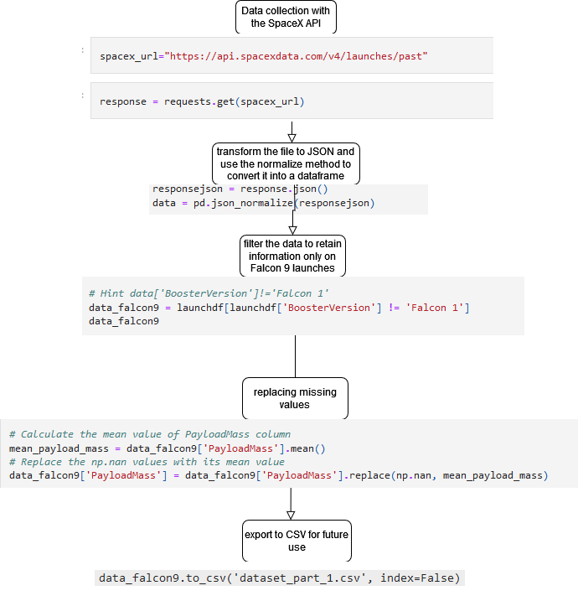
Data Collection – SpaceX API
I require the data from the SpaceX API. We transform the file to JSON and use the normalize method to convert it into a data frame. We filter the data to retain information only on Falcon 9 launches, remove any missing values, and export to CSV for future use.
GitHub url: https://github.com/Heleiley/Final-Assignment/blob/main/jupyter-labs-spacex-data-collection-api.ipynb

Slide 9
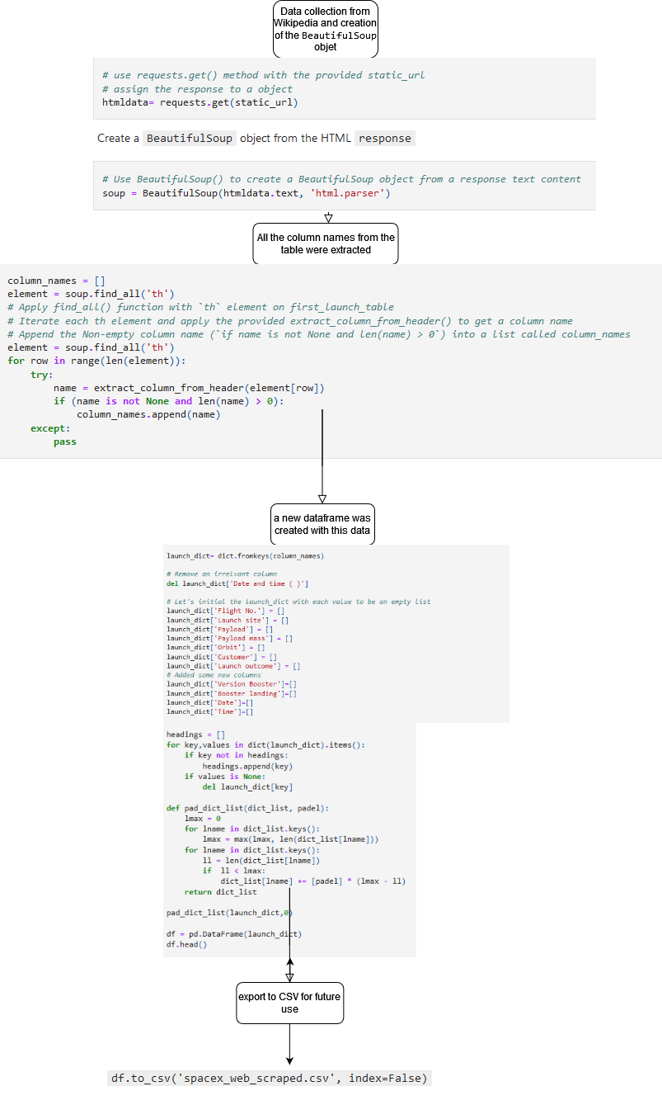
Data Collection - Scraping
Data from Wikipedia about SpaceX's Falcon 9 launches was used. All the column names from the table were extracted, a new data frame was created with this data, and this data frame was exported to CSV for future use
GitHub URL: https://github.com/Heleiley/Final-Assignment/blob/main/jupyter-labs-webscraping.ipynb

Slide 10
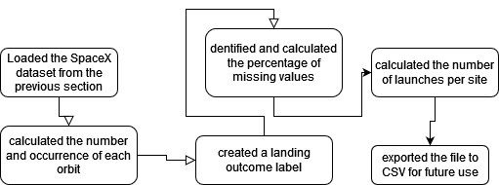
Data Wrangling
We loaded the SpaceX dataset from the previous section, identified and calculated the percentage of missing values, calculated the number of launches per site, calculated the number and occurrence of each orbit, calculated the number of missions per type of orbit, created a landing outcome label from the Outcome column, and exported the file to CSV for future use
GitHub URL:https://github.com/Heleiley/Final-Assignment/blob/main/labs-jupyter-spacex-Data%20wrangling.ipynb

Slide 11
EDA with Data Visualization
We used the following charts: scatter, bar chart, point and line chart. These were used because they better highlight the relationships between the different variables utilized and better show comparisons
GitHub URL: https://github.com/Heleiley/Final-Assignment/blob/main/edadataviz.ipynb

Slide 12
EDA with SQL
SQL queries Performed
Display the names of the unique launch sites
Display 5 records where launch sites begin with the string 'CCA'
Display the total payload mass carried by boosters launched by NASA (CRS)
Display average payload mass carried by booster version F9 v1.1
List the date when the first succesful landing outcome in ground pad was acheived.
List the names of the boosters which have success in drone ship and have payload mass greater than 4000 but less than 6000
List the total number of successful and failure mission outcomes
List the names of the booster_versions which have carried the maximum payload mass. Use a subquery
List the records which will display the month names, failure landing_outcomes in drone ship ,booster versions, launch_site for the months in year 2015.
Rank the count of landing outcomes (such as Failure (drone ship) or Success (ground pad)) between the date 2010-06-04 and 2017-03-20, in descending order.
GitHub URL: https://github.com/Heleiley/Final-Assignment/blob/main/jupyter-labs-eda-sql-coursera_sqllite(1).ipynb

Slide 13
Build an Interactive Map with Folium
created and used the following objects in the Folium map
Markers: to create marks on the map for example, launch sites
Circle: used to create circles over the marks
cons: used to create icons on the map
PolyLine: created to draw lines between marks or points
MarkerCluster: created for those points where there are many markers with the same coordinates
GitHub URL: https://github.com/Heleiley/Final-Assignment/blob/main/lab_jupyter_launch_site_location.ipynb

Slide 14
Build a Dashboard with Plotly Dash
I created an interactive dashboard with Plotly and Dash. Some pie charts were created to show the total launches from certain sites, and a scatter plot was also created to show the relationship between payload mass and the class used
GitHub URL: https://github.com/Heleiley/Final-Assignment/blob/main/spacex_dash_app.py

Slide 15
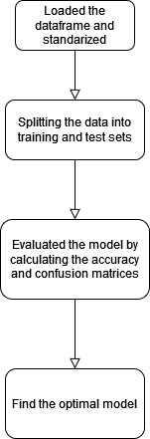
Predictive Analysis (Classification)
I created the model by creating columns for the class, standardizing the data, and splitting the data into training and test sets. We evaluated the model by calculating the accuracy and confusion matrices, and then plotted the results. Finally, we aimed to find the optimal model by searching for the best hyperparameters and comparing the models with the highest accuracy
GitHub URL: https://github.com/Heleiley/Final-Assignment/blob/main/SpaceX_Machine%20Learning%20Prediction_Part_5(1).ipynb

Slide 16
Results
It can be concluded that both the API and web scraping are capable of collecting and filtering SpaceX data that was later reused in subsequent labs. However, EDA with SQL was more useful for filtering the data as we could use specific functions for this purpose. Regarding the maps, we were able to see graphical data of launch sites, distances between them, and distances between these sites and different urban areas, which would have been difficult to understand without using Folium. With Dash, we were able to visualize the launch success rate by site thanks to the pie charts. Regarding the predictive analysis, we can conclude that considering the model scores, the decision tree is the best for analysis

Slide 17

Section 2

Slide 18
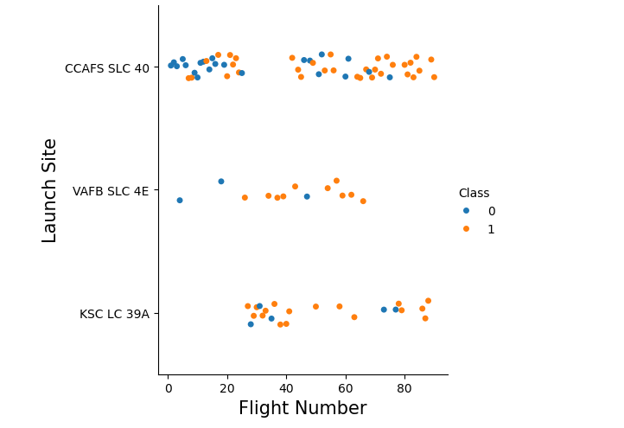
Flight Number vs. Launch Site
We can visualize that the CCFS SLC 40 site has the highest number of successful launches, considering that Class 0 represents failed launches and Class 1 represents successful ones

Slide 19
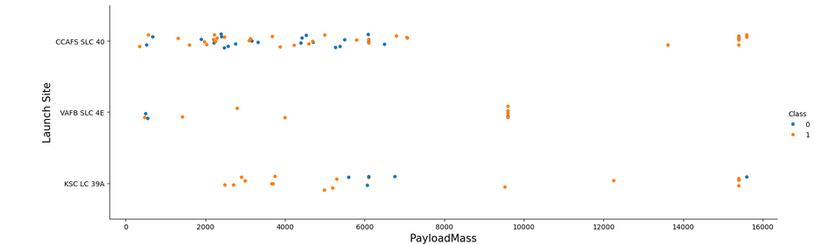
Payload vs. Launch Site
"We can visualize that the majority of launches with low payload mass were from the CCAFS SLC 40 site. It is also the site with the most failed launches with low payload mass

Slide 20
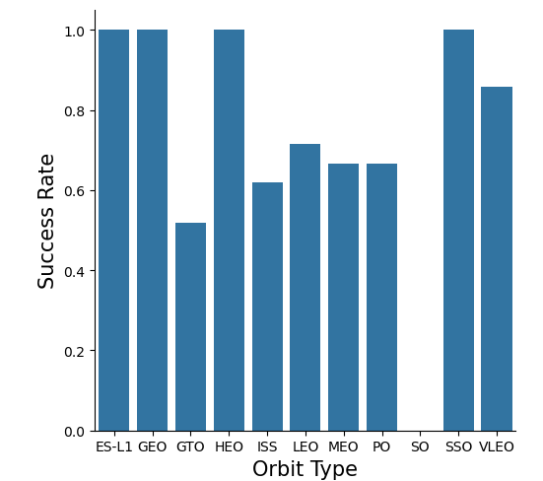
Success Rate vs. Orbit Type
We can visualize that the ES-L1, GEO, HEO, and SSO orbits have the highest successful launch ratio, while the SO orbit did not achieve any successful launches.

Slide 21
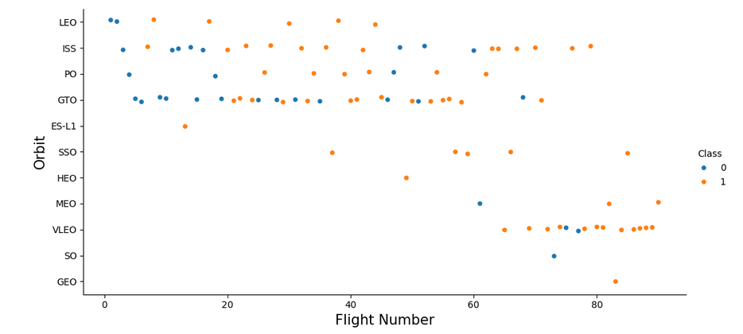
Flight Number vs. Orbit Type
We can observe that in the LEO orbit, success seems to be related to the number of flights. Conversely, in the GTO orbit, there appears to be no relationship between flight number and success.

Slide 22
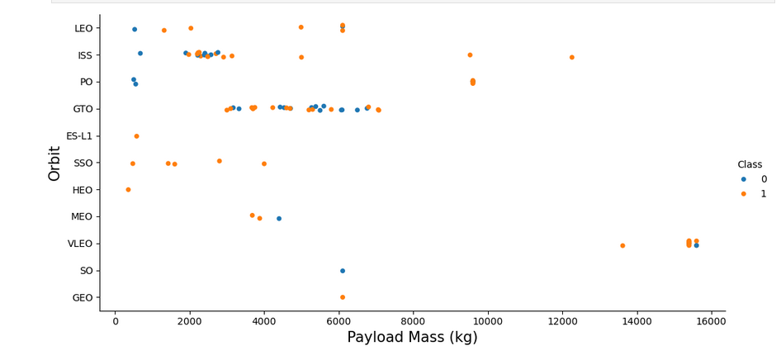
Payload vs. Orbit Type
With heavy payloads the successful landing or positive landing rate are more for Polar,LEO and ISS. However, for GTO, it's difficult to distinguish between successful and unsuccessful landings as both outcomes are present

Slide 23
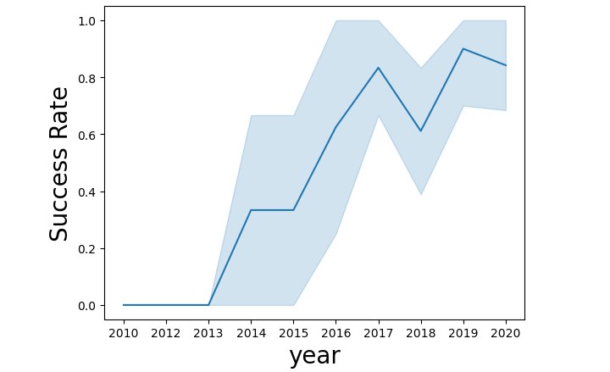
Launch Success Yearly Trend
you can observe that the success rate since 2013 kept increasing till 2020

Slide 24
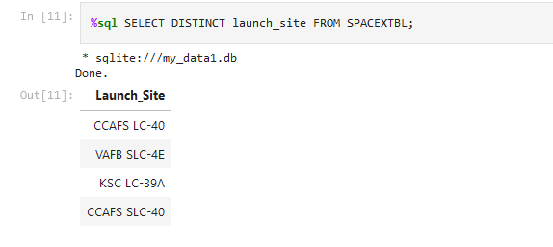
All Launch Site Names
We used the 'distinct' keyword to see only the unique launch sites.

Slide 25
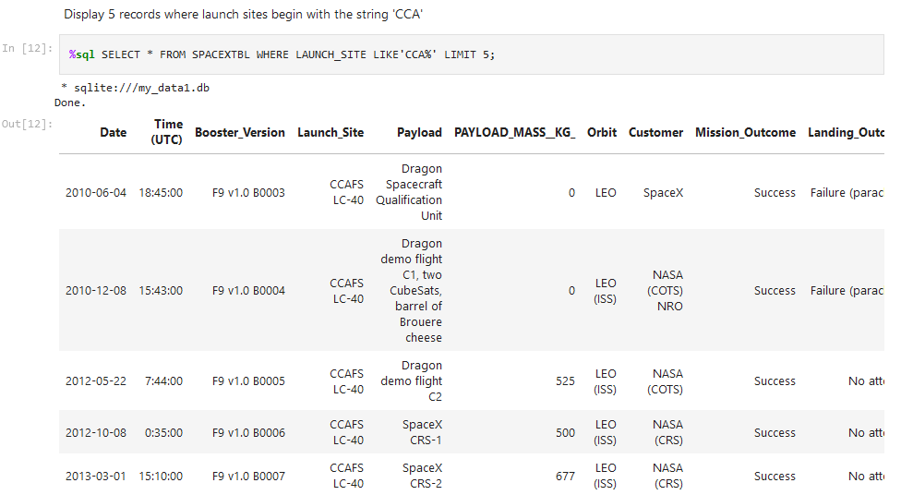
Launch Site Names Begin with 'CCA'
We used the 'like' keyword to search within launch_site for launch sites that have CCA in their name And we limited it to 5 to show only the first 5 results.

Slide 26
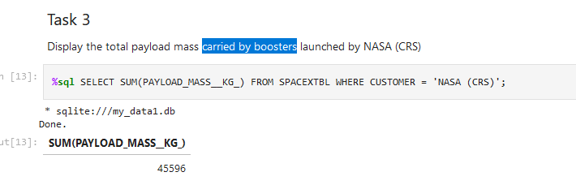
Total Payload Mass
we used the SUM() function to find out the total payload mass carried by boosters

Slide 27
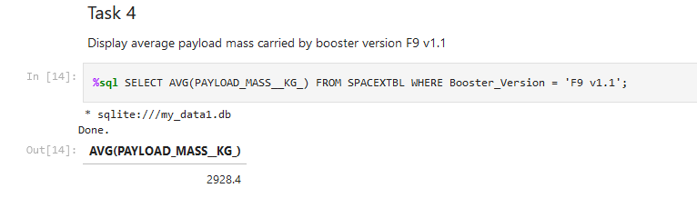
Average Payload Mass by F9 v1.1
We used the AVG() function to calculate the amount of mass carried by the booster version F9 v1.1 using the 'where booster_Version = F9 V1.1' clause

Slide 28
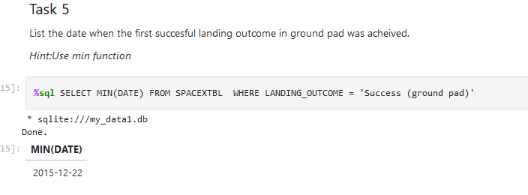
First Successful Ground Landing Date
With MIN(DATE), we can find the date of the first successful landing

Slide 29
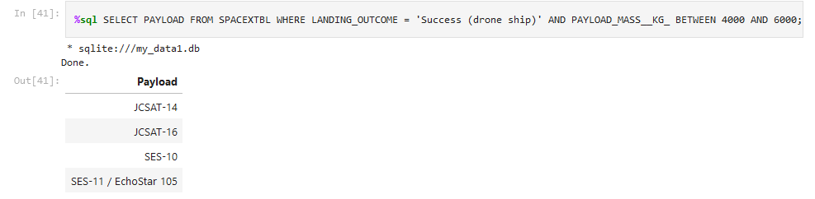
Successful Drone Ship Landing with Payload between 4000 and 6000
We searched only for successful drone ship landings using the 'Where' clause and restricted the payload mass to be greater than 4000 but less than 6000

Slide 30
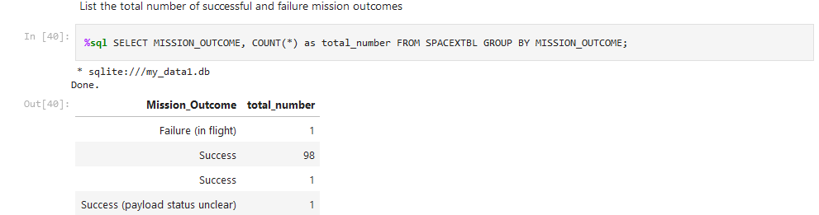
Total Number of Successful and Failure Mission Outcomes
The query counts the number of failed and successful missions outcome

Slide 31
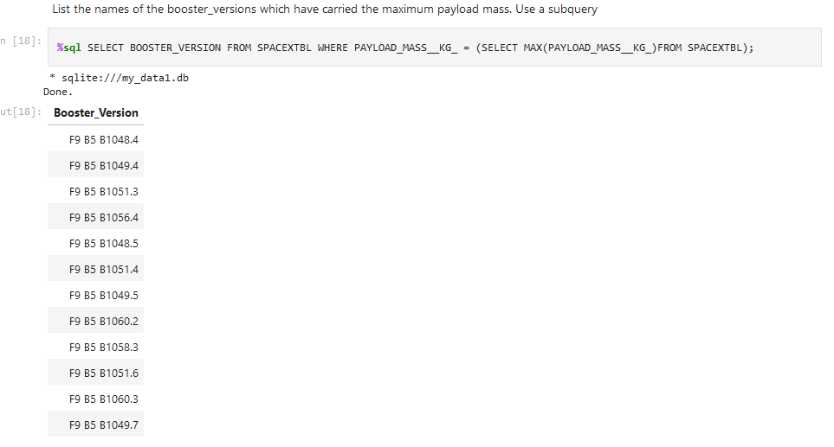
Boosters Carried Maximum Payload
We can find out which booster versions had the maximum payload mass using the SELECT MAX(payload_mass_kg) statement

Slide 32
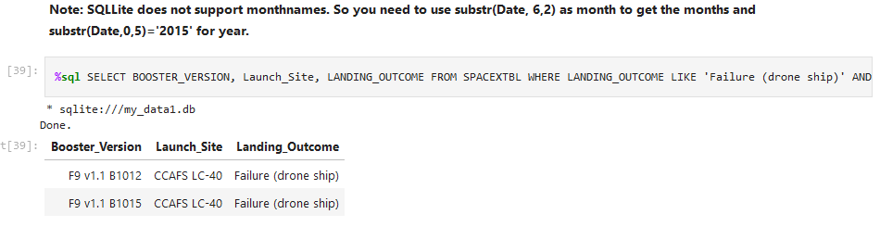
2015 Launch Records
We used combinations of where, like, and to filter the failed landings on drone ships, their booster versions, and the launch site.

Slide 33
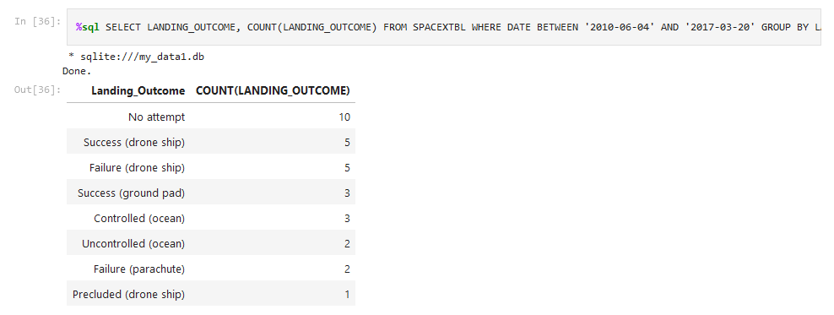
Rank Landing Outcomes Between 2010-06-04 and 2017-03-20
With where we restricted the search to be between 2010-06-04 and 2017-03-20. Then, we used group by for landing_outcome and sorted it in descending order with DESC

Slide 34

Section 3

Slide 35
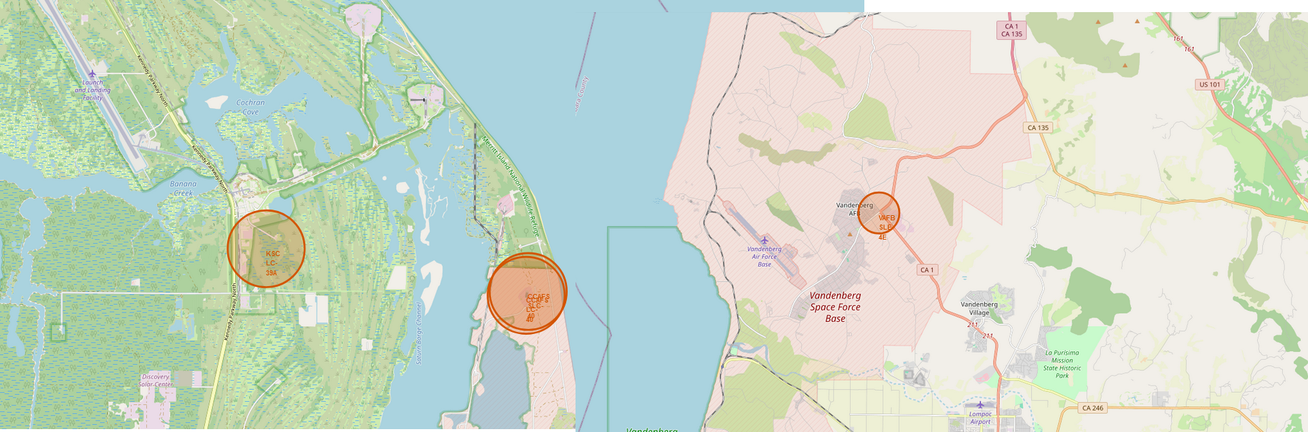
Launch sites locations
We can see that in most cases, the launch sites are near coastal areas

Slide 36
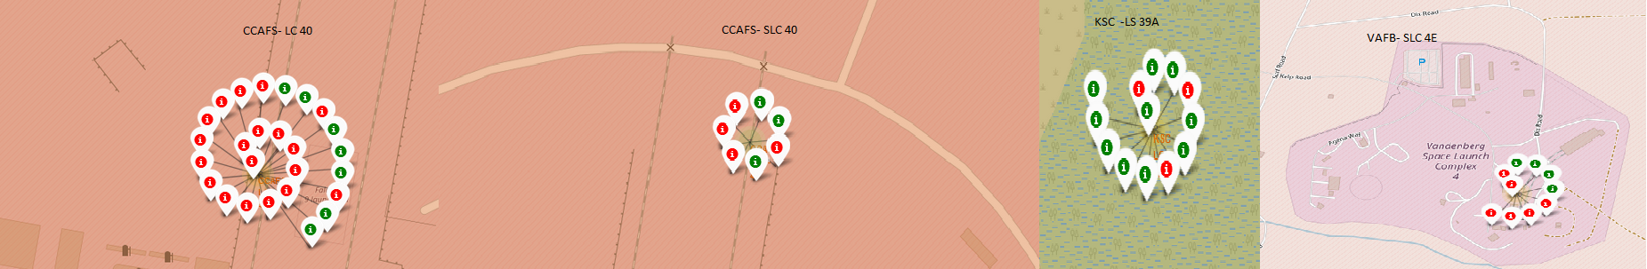
Launch sites, failed launches, and successful launches
We can see the number of launches, which ones were successful and which ones were not, among the different launch sites. For example, we can see that the site with the most launches was CCAFS LC40, but it also has the highest number of failed launches (color red mark a failed launch).

Slide 37
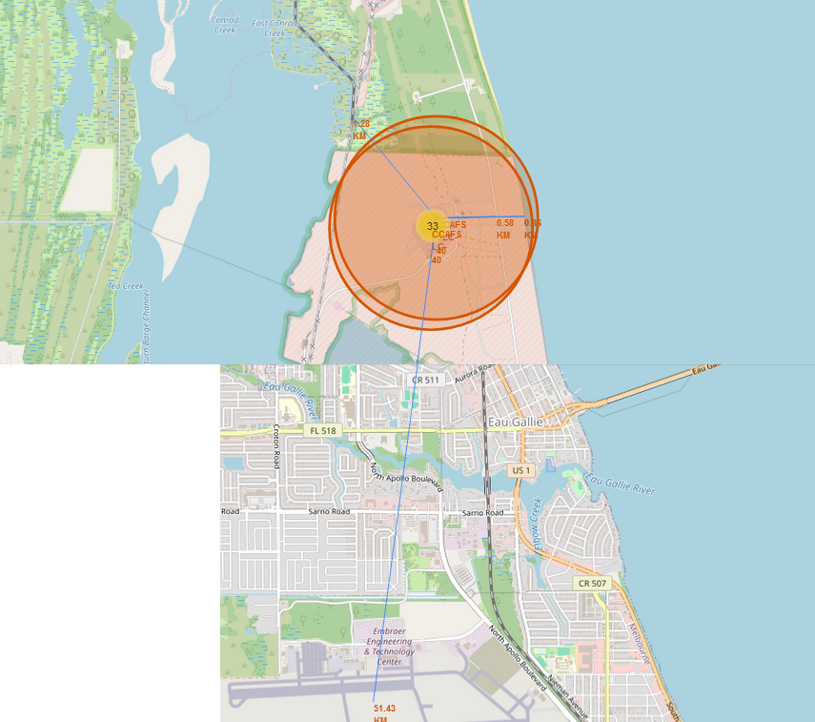
Launch Site proximity
I created a line on the map to see the distance between the launch site and a train station, a city, and a coastal area For example, the nearest city is 51.43 km away

Slide 38

Section 4

Slide 39
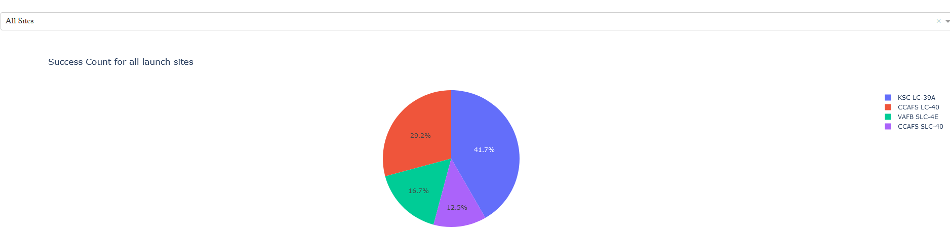
Success Count for all sites
In this pie chart, we can visualize the success ratio of launches from all the launch sites. We can see that among the sites, the one with the highest chance of a successful launch is KSC LC-39A

Slide 40
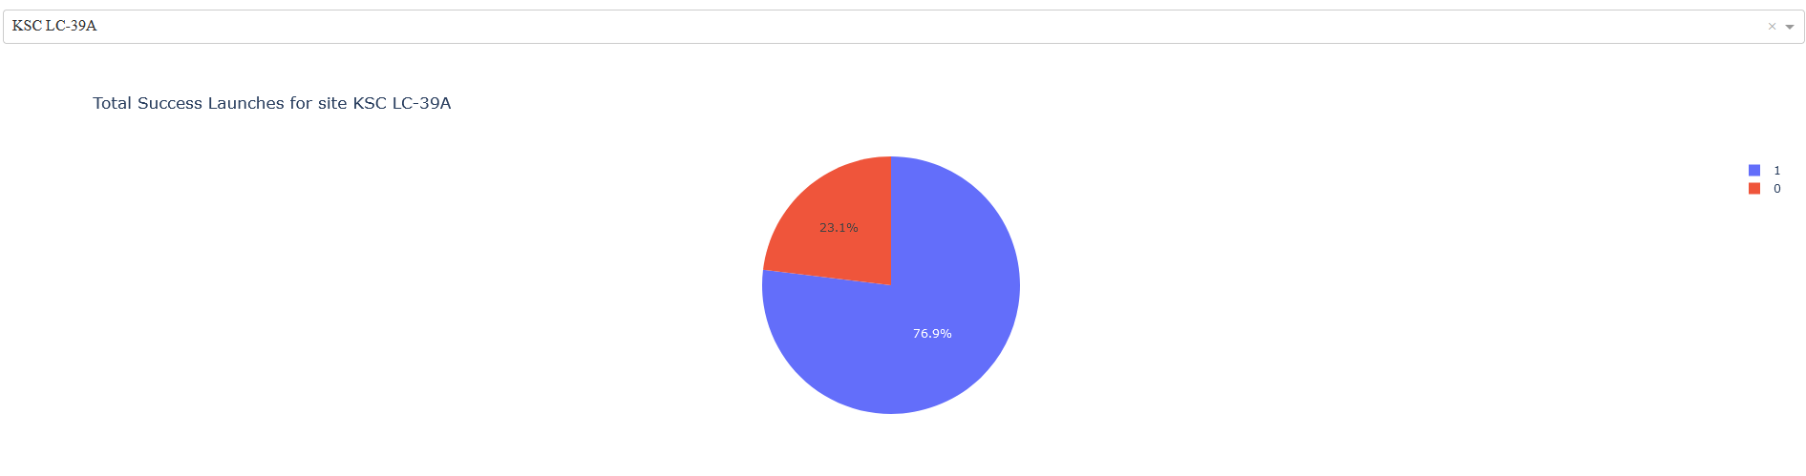
<Dashboard Screenshot 2>
We can see that indeed the KSC LC 39A site has the highest launch success rate, with 76.9%

Slide 41
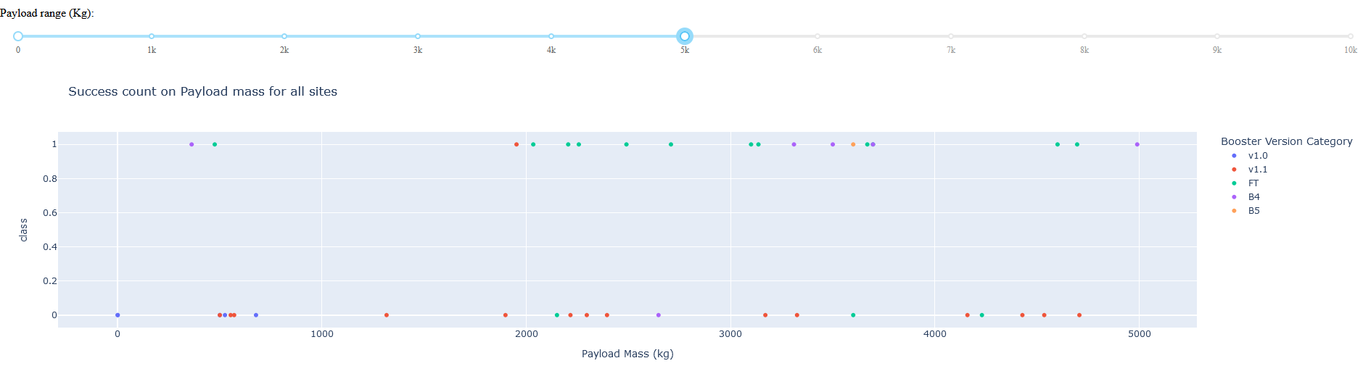
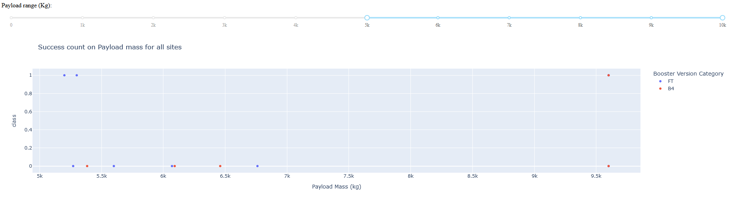
<Dashboard Screenshot 3>
We can see that there is a significant difference in success between light and heavy payload masses

Slide 42

Section 5

Slide 43
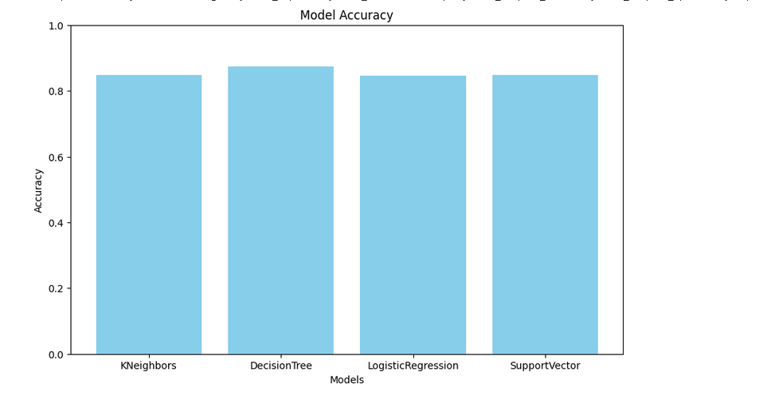
Classification Accuracy
According to the graph, we can see that the Decision Tree has the highest score

Slide 44

Confusion Matrix
The confusion matrix for the decision tree shows that the classifier can distinguish between the different classes. The major problem is the false positives

Slide 45
Conclusions
The larger the flight amount at a launch site, the greater the success rate at a launch site.
Launch success rate started to increase in 2013 till 2020.
Orbits ES-L1, GEO, HEO and SSO had the most success rate.
KSC LC-39A had the most successful launches of any sites.
The Decision tree classifier is the best machine learning algorithm for this task.

Slide 46
Appendix
Include any relevant assets like Python code snippets, SQL queries, charts, Notebook outputs, or data sets that you may have created during this project

Slide 47


